Slide 1

A Contribution to Nanotechnology Development Strategy
ETM 534/634 - TECHNOLOGY ROADMAPPING
Summer 2022
Professor: Tugrul U Daim
Group 3: Farzaneh Noroozi- Amrutha Shikaripura Jagadeesh-Elsamol Elbalazi- Vaishali Porthi- Haydar Mohammad- Nedzad Ljaljic

Slide 2
IEEE TRANSACTIONS ON ENGINEERING MANAGEMENT, VOL. 69, NO. 1, FEBRUARY 2022
Introduction
Roadmapping in Regional Technology Foresight:
A Contribution to Nanotechnology Development Strategy
This article presents integrating roadmapping and describes its application in a project entitled “Technological foresight ‘NT FOR Podlaskie 2020’ Regional strategy of nanotechnology development”.
Joanicjusz Nazarko, Joanna Ejdys , Alicja E. Gudanowska, Katarzyna Halicka, Anna Kononiuk, Andrzej Magruk , and Łukasz Nazarko
The research intended to define strategic directions for the development of Podlaskie region utilizing the achievements of nanotechnology
15
Article Number 15

Slide 3
The article's authors agree that modularity for integrated roadmapping helps technologies, products, applications, markets, and society overreach national challenges.
The author presented the formation of megatrends and subtends in five time zones, which directly inspired the presentation of time zones in roadmaps for nanotechnology development.
SECTION II.
Background Literature

Slide 4
SECTION III.
Foresight in Shaping the Technological Development Strategy of a Region
SECTION IV.
"NT FOR Podlaskie 2020": Rationale and Methodology
A. Rationale, Scope, and Aims of the Project
The authors intended to combine regional foresight with technology foresight and technology roadmapping. It was assumed that would prove valuable on both scientific and policy levels.
Grant from the EU Operational Program 2007–2013.
Attempts to promote nanotechnology in a situation where traditional industries cannot accelerate the region's development.
More than 160 experts were involved in the project.

Slide 5
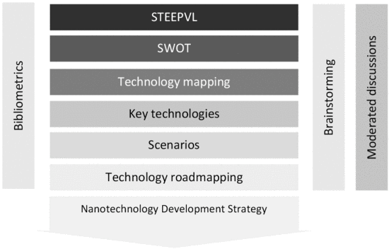
B. Research Methodology Implemented in the Project
To include roadmapping in the research process, we need to demonstrate the interrelationship between resources (human, financial, and material), the R&D, and the potential market of nanotechnology
As shown in fig. 2, the used methods were
Bibliometric analysis
STEEPVL analysis
SWOT analysis
Technology mapping
Key technology
Scenarios
Roadmapping
Brainstorming
Moderated discussions
fig. 2

Slide 6
SECTION V.
Methodological Framework for Roadmap Development
Collecting information from experts by using the created tools
Categorization and selection of the collected data
Analyzing the links among all the key technologies
In the final phase, the relations among priority technologies were analyzed graphically.
stages of technology mapping:
Literature studies result in the diagnosis of the current state of technologies and the idea of technology mapping
Implementation of technology sheets and the technology relation matrix

Slide 7
SECTION VI.
Results
Key Nanotechnologies
Scenarios for Nanotechnology Development
scenarios consisted of 65 social, technological, economic, environmental, political, legal, and value-related factors.
The final group of priority technologies was formed by these 7 technologies:
Nanotechnologies for cutting tools and wood processing
Composite materials-permanent dental fillings
Nanomaterials and nanocoating in medical equipment
Topcoat nanotechnologies for biomedical applications
Nanotechnologies related to special textiles such as dressings
Nano-powder technologies for the use in plastics processing, paint, and varnish compositions
Nano-structuring technologies for metals and light alloys
Roadmaps
The necessary increase in financial outlays in all three time-perspectives has been estimated by the expert at an average level, USD 1.5–15 million.

Slide 8
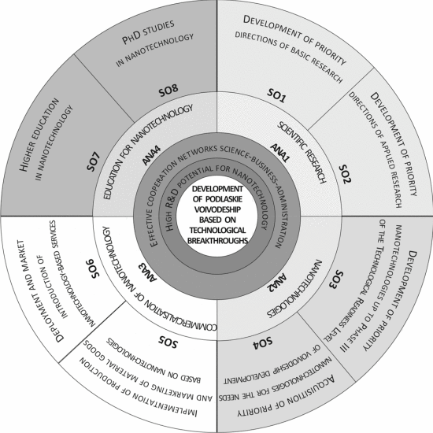
Strategy of Nanotechnology Development
The map is based on a circle, the plane of which is divided into four parts of nanotechnology activity: research (ANA1), nanotechnology (ANA2), commercialization of nanotechnology (ANA3), and education for nanotechnology (ANA4).
The basic elements of the strategy and their mutual relations are graphically presented using a nanotechnology development map

Slide 9
SECTION VII.
Discussion
SECTION VIII.
Conclusion
the greatest chances for the development of nanotechnologies are in the conditions of high R&D potential for nanotechnologies and effective regional networks for business, science, and administration
It was revealed that innovative strategy formulation methodology combined regional foresight and technology foresight was an inspiration for academia. However, the recommendation to make nanotechnology development a regional priority never made it to the official strategic documents.
This concept aims to highlight the function of investment in innovation in high technology sectors like universities, local government, and civil society.

